Slide 1
Introduction to the Machine Learning Workflow
ENGR 96A: Python and Machine Learning

Slide 2
Overview
Figure out the problem
Separate the data
Consider what type of model to use
Pick hyperparameters
Train
Test
Save best parameters
Adjust hyperparameters or model if necessary
Repeat from step 5

Slide 3
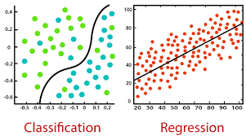
Figure out the problem
Consider what you want your result to be
Consider what the data looks like
Supervised
Classification, regression
Unsupervised
Clustering, dimensionality reduction

Slide 4
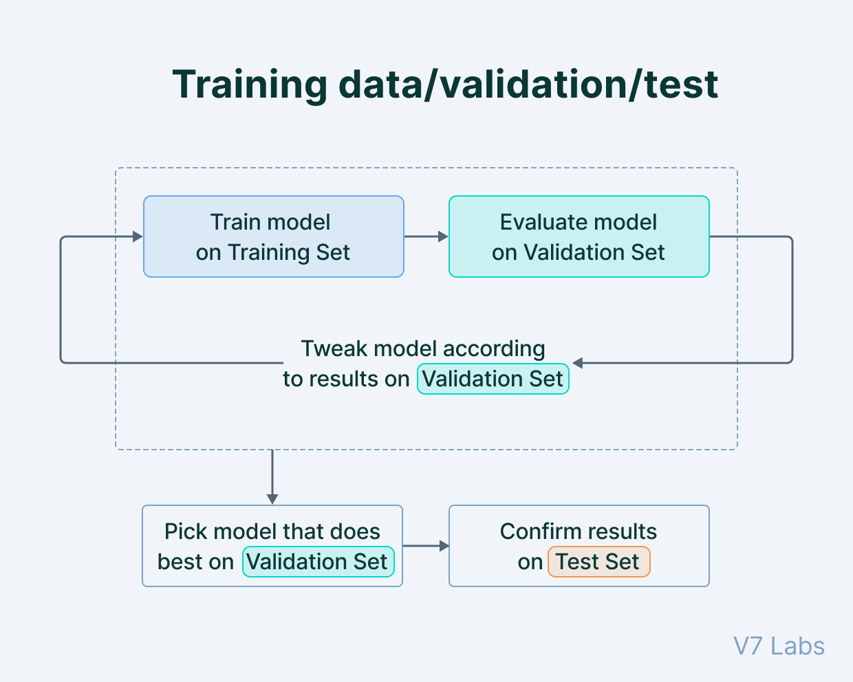
Separate the data
Three sets of data
Training set
For training the model
Validation set
To prevent overfitting
Testing set
To test the accuracy of the model on new data
Optional: k-fold cross validation

Slide 5
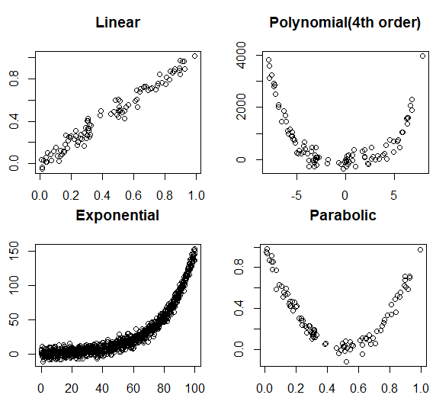
Consider what kind of model to use
Dependant on the type of problem
Simple models:
Polynomial, exponential, logarithmic
Neural networks
Consider what types of layers, sizes, how many
What kind of loss function will be used
What kind of optimizer will be used

Slide 6
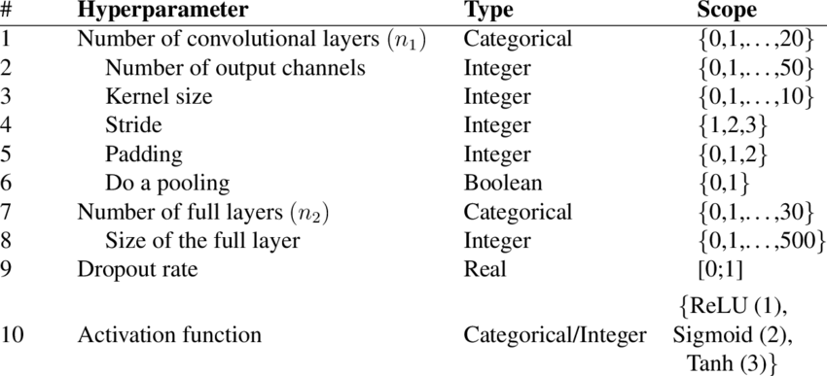
Choose hyperparameters
These are the parameters of your model set before training
Learning rate, momentum, regularization
You will develop intuition the more machine learning problems you do
Hyperparameters can be swept

Slide 7
Train your model
Now you will run the training sequence
General model: loop
Load training data
Train on full set of training data
Validate with validation data
Optional: if validation is worse than previous go back to previous
Report important information
Loss, regularization, epoch
At the end test on testing data
In Pytorch this is very simple

Slide 8
Save your best parameters
Save the best parameters of your model along with any other information you want from the model
Final loss, training accuracy, testing accuracy, hyperparameters, etc.
Complex machine learning models take a long time to train
Deleting all of your work without saving is not good

Slide 9
Adjust hyperparameters or model
If you are satisfied with your model then great, you are done!
Otherwise consider what hyperparameters to adjust, or if the model needs adjustment
It can be helpful to graph some relevant information to see where things went wrong
For example: loss over epochs
Running on a small number of epochs and sweeping over hyperparameters can be useful

